Slide 1
ELECTIVE COURSE: INTRODUCTION TO ARDUINO DESIGN BOARD
Authors:
Roberto Brauer Di Renna
Thiago Elias Bitencourt Cunha
Tutor:
D.Sc. Alexandre Santos de la Vega

Slide 2
Summary
PET Program
PET-Tele Group
Arduino Project Timeline
Motivation & Objectives
Arduino Design Board
Pilot Course
Elective Course
Next Steps

Slide 3
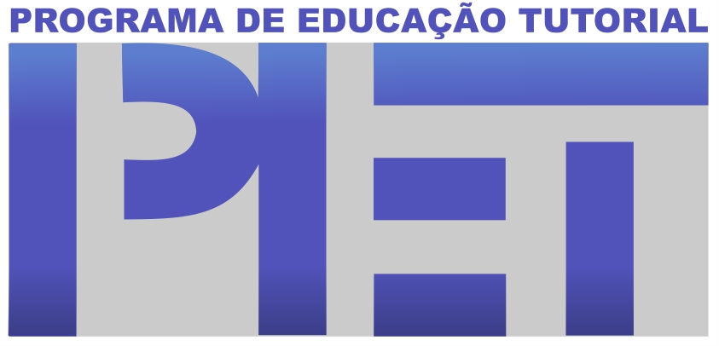
Programa de Educação Tutorial - PET
Objectives
Formation

Slide 4
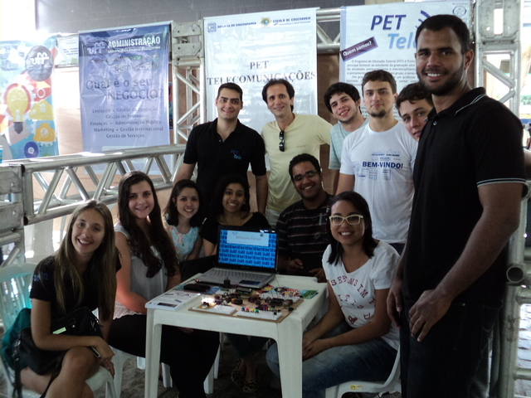
PET-Tele Group
History
Activities
- Workshop organization
- Courses
- Researches
- Maintenance websites

Slide 5
Arduino Project Timeline
The group starts to study the Arduino platform.
The same students elaborate an article presented at brazillian national level congress.
Roberto Brauer, Rodrigo Brasil and Thiago Bitencourt started to update the tutorial and offered an pilot course.
2009 | 2010 | 2011 | 2012 | 2013 | 2014
As the results of the study, integrants begin to write na Arduino tutorial.
The first minicourses has been offered at Telecomunications week.
The elective course has been accepted on Telecommunications department and the students ministrate the classes.

Slide 6
Motivations
Objectives
Conciliate research, education and extension items into only one project.
To provide the students a completely practical discipline.
To rescue old group projects.
A lot of students interested in learn and develop Arduino based designs.
Group members with knowledge in Arduino.

Slide 7
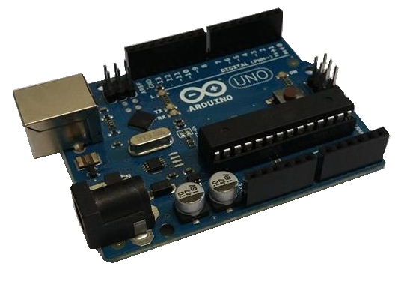
Arduino Design Board
Big community at Internet
Easy programming
Low cost
Practical to use at academic environments

Slide 8
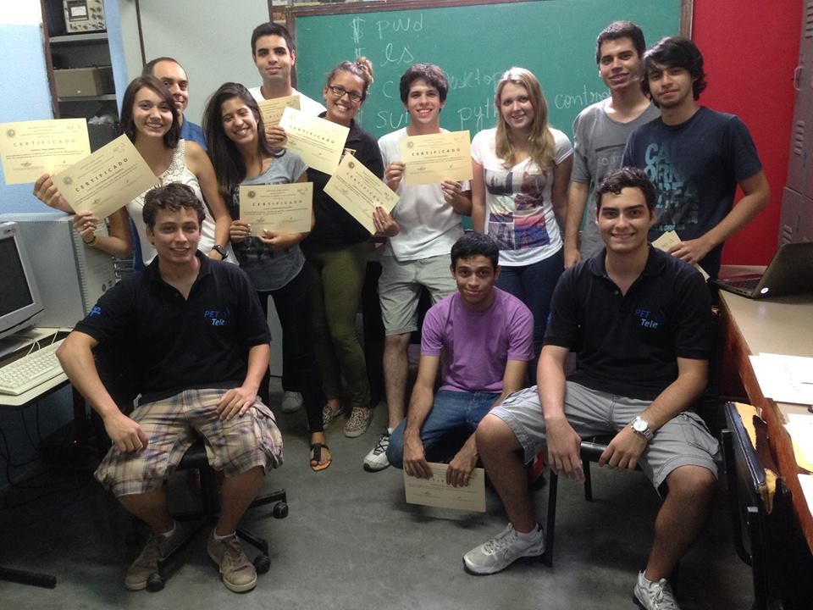
Pilot Course: Class
Planning
Duration
C programming language course
Facilities of the lab

Slide 9
Pilot Course: Statistics
Questionnaire
Students impressions
Points to improve

Slide 10
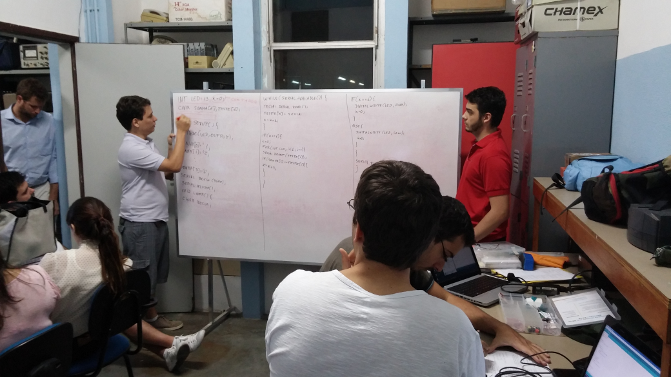
Elective Course: Class
Number of students
Designs proposed
Evaluation

Slide 11
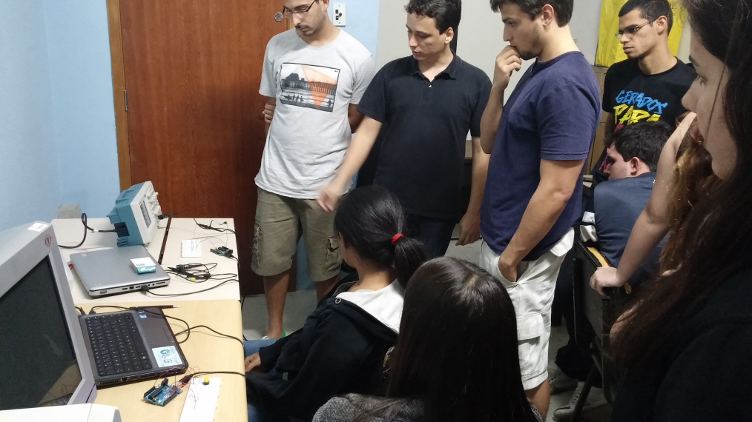
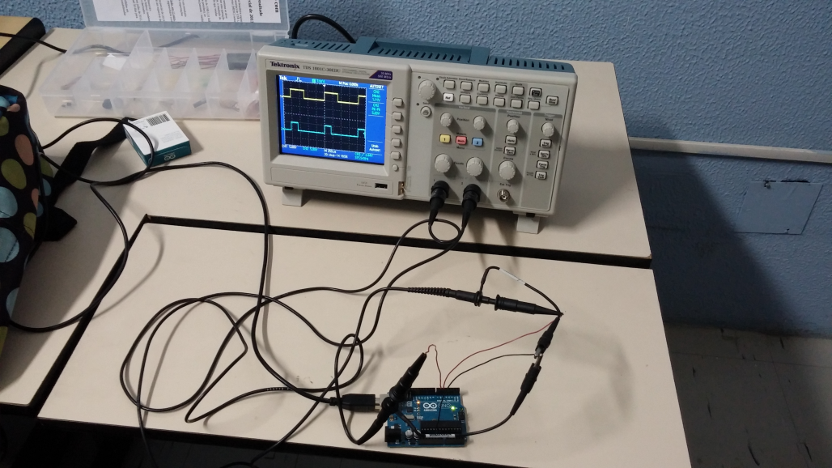
Elective Course: Design Example

Slide 12
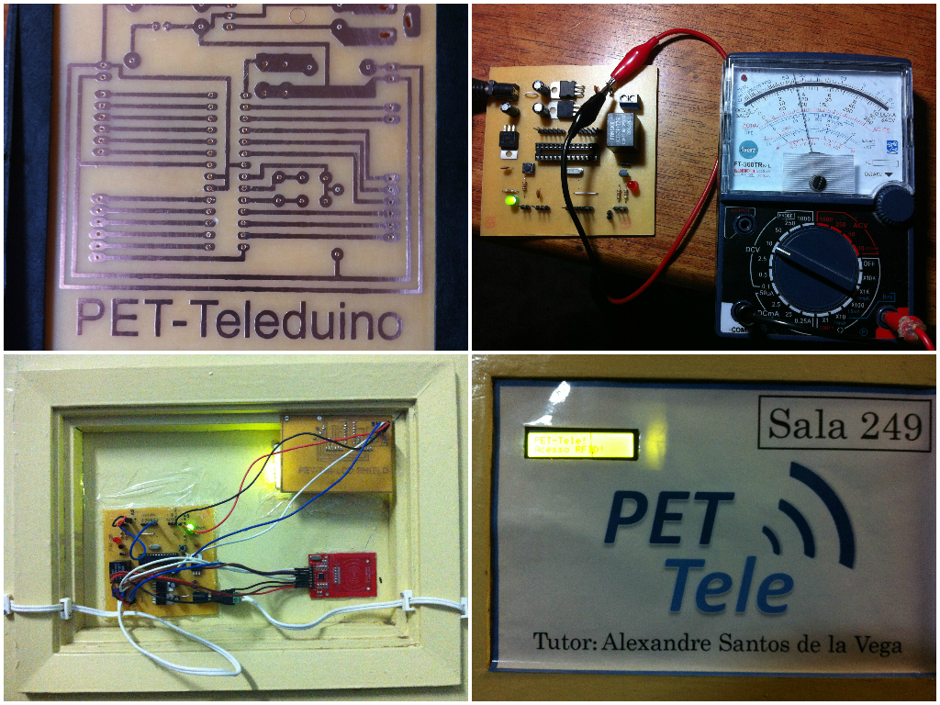
Home made PCB/Shields and RFID Access
Homemade technique to confection PCBs
Tutorial
RFID control access

Slide 13
Next Steps
PCB/shields minicourse
Invitation to ministrate classes at German Corcovado School
To keep offering the course in the coming periods

Slide 14
Recommendations
The practical classes are important to consolidate the theory. So, they have to be estimulated.
Teachers should realize the needs and the motivations of the students.
Teachers have to keep the disciplines uptodated.

Slide 15
Contacts
Roberto Brauer Di Renna
robertobrauer@telecom.uff.br
Thiago Elias Bitencourt Cunha thiagoelias_cunha@telecom.uff.br
Alexandre Santos de la Vega
delavega@telecom.uff.br
PET–Tele: http://www.telecom.uff.br/pet

